Slide 1
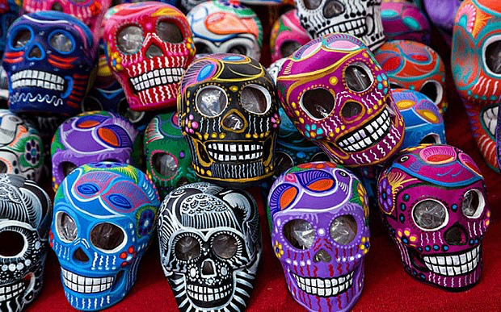

Traditions and Holidays

Slide 2
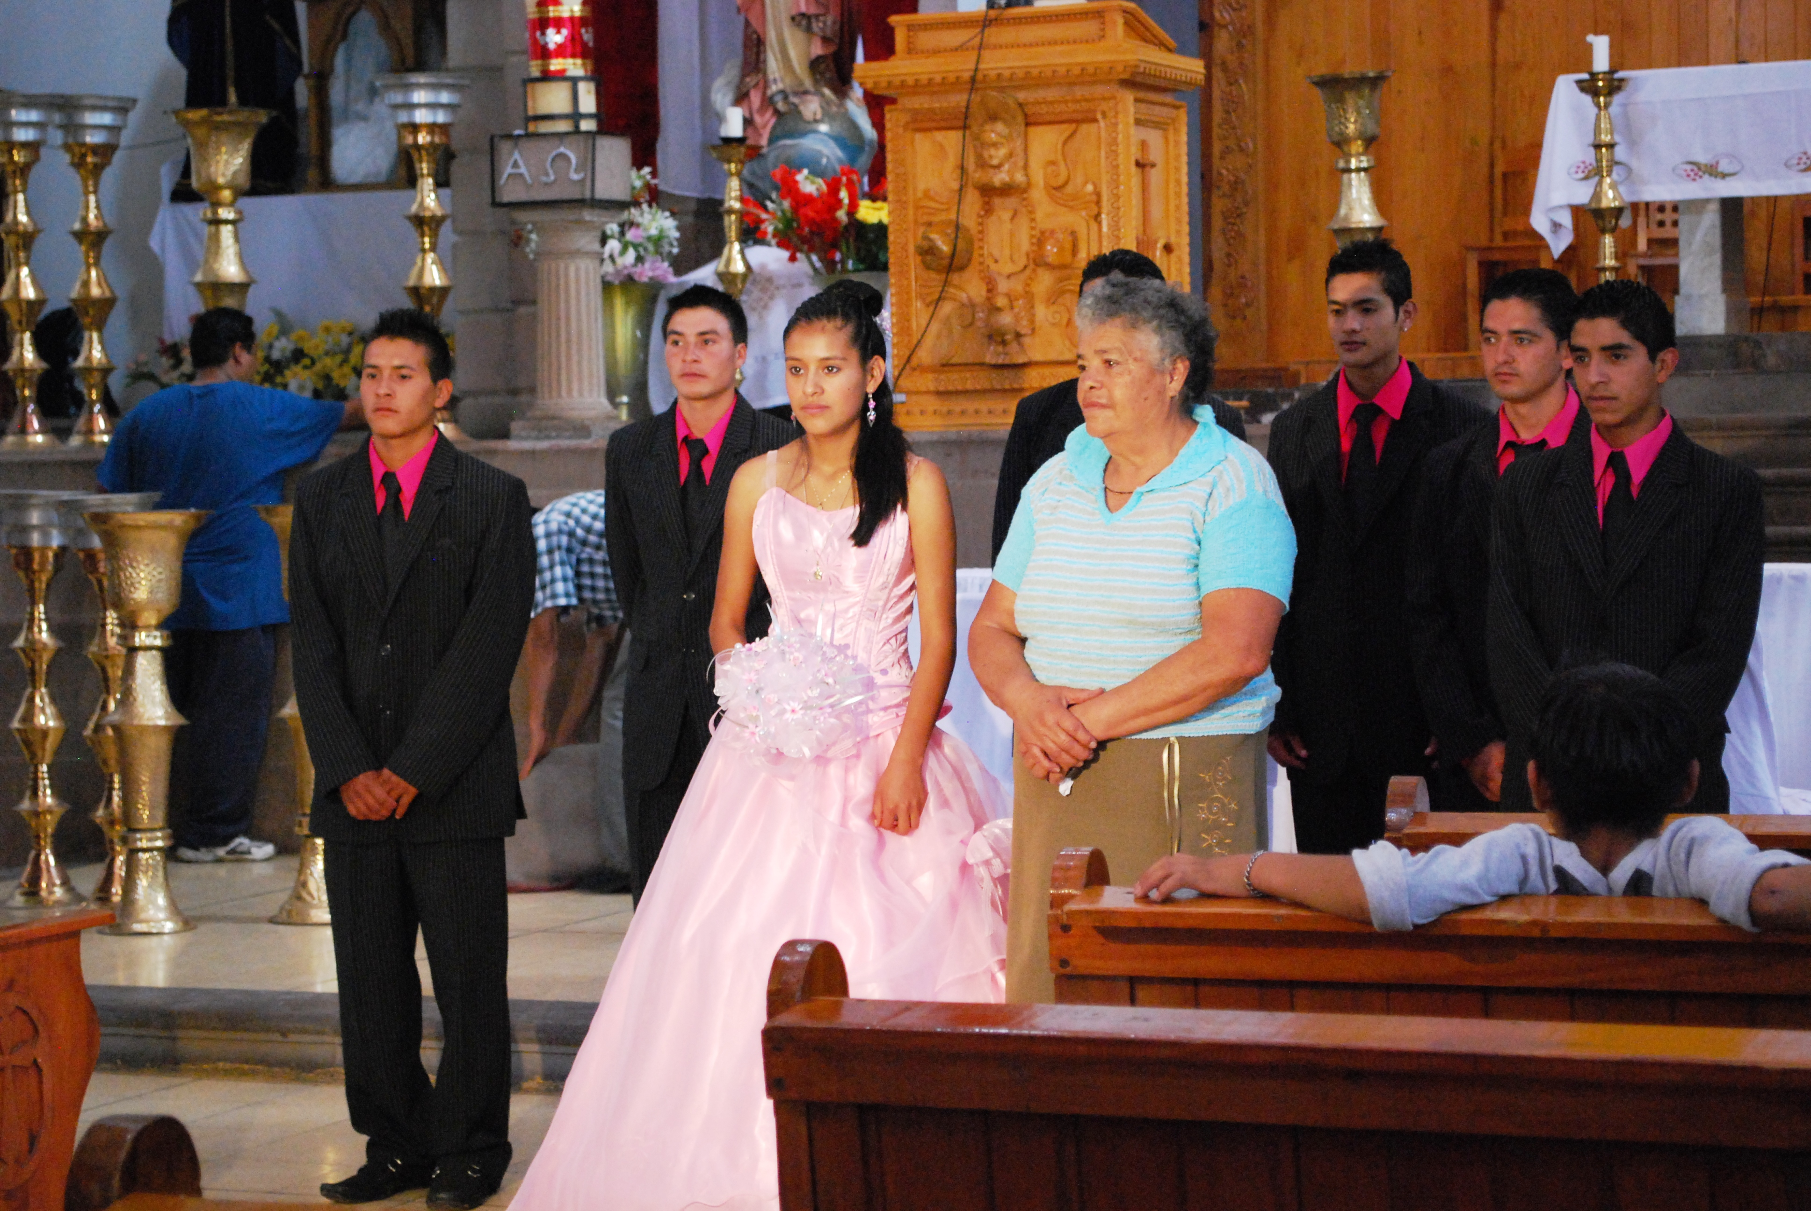
What is a tradition?
The transmission of customs or beliefs from generation to generation.
Quinceañera celebration, special recognition of a Latina’s 15th birthday.
Notes:
Caption: Quinceañera celebration, special recognition of a Latina’s 15th birthday.
A tradition is the transmission of customs or beliefs from generation to generation.
Often times, popular traditions are practiced by a majority of citizens in a certain country.
For example, most Americans have turkey on Thanksgiving.
However, many families have their own special traditions that they do every year, as well.

Slide 3
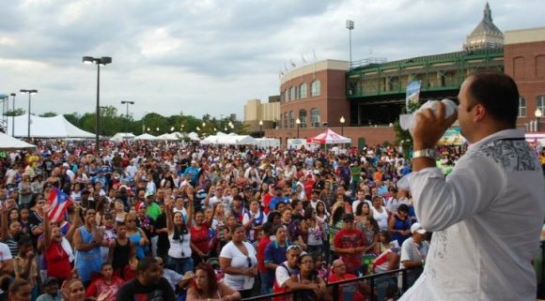
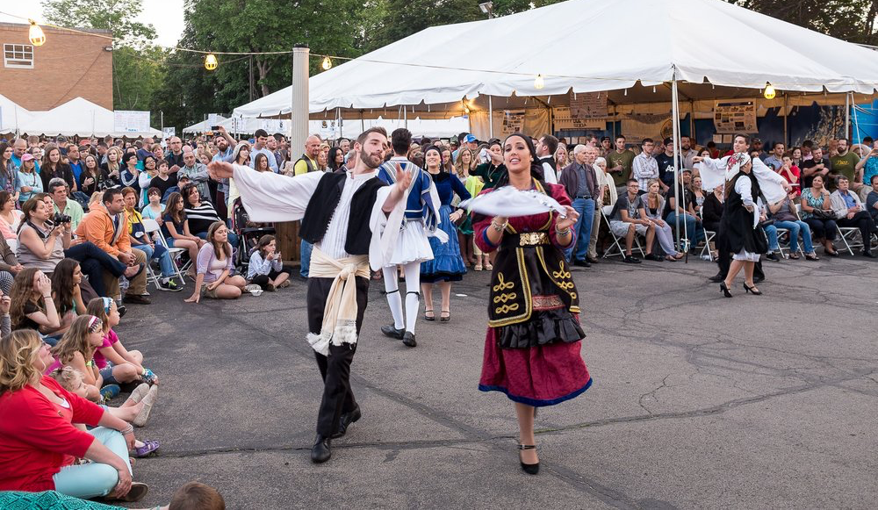
Festivals
Rochester Puerto Rican Festival
Rochester Greek Festival
Notes:
Here in America, attending festivals is an important tradition for people of certain backgrounds. These festivals give them an opportunity to celebrate their heritage and get a taste of their culture right here in the United States.
Puerto Rican Festival
For example, the Rochester Puerto Rican festival has been held in Rochester since 1969. Over 7,000 visitors attend the festival each day. Although anybody can attend, it allows many Rochester Puerto Ricans and other Latinos to feel connected to their roots. At this festival, visitors often enjoy watching the Miss Puerto Rico of Rochester pageant. They also enjoy Puerto Rican food, music/dancing, and artwork.
Greek Festival
Similarly, anyone can attend the Rochester Greek Festival. However, it allows people from Greek backgrounds to feel a connection with their culture. Those who attend this festival enjoy dance performances, shopping, and traditional Greek food. Both festivals are held in the summertime, right here in Rochester.

Slide 4
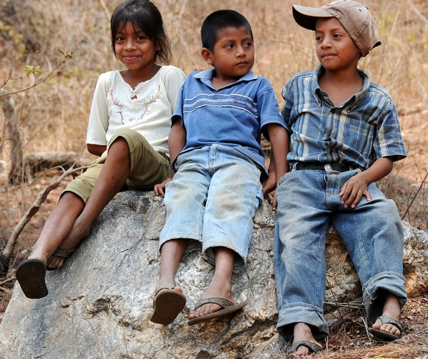
What is a holiday?
A day of festivity or recreation when no work is done.
Notes:
A holiday is a day of festivity or recreation when no work is done.
On major holidays, we do not go to school/work and spend time with friends and family.
For other holidays, students still attend school, but we still celebrate important people/events on those days.
On many holidays, there are popular traditions celebrated by many citizens in a certain country.
Families also have their own special traditions that they celebrate on holidays.

Slide 5
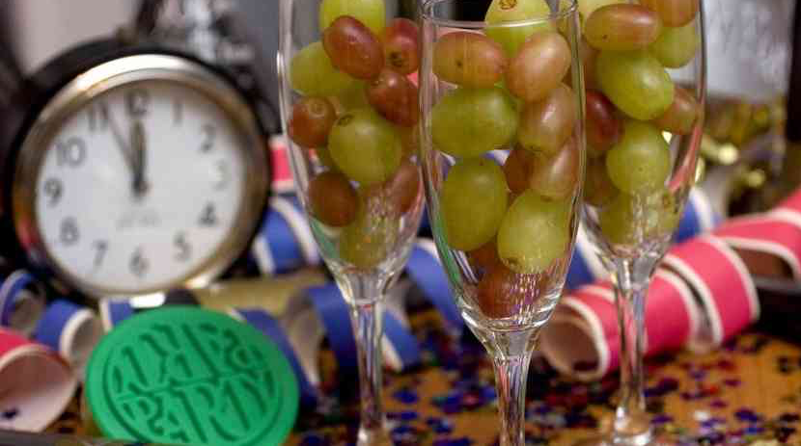
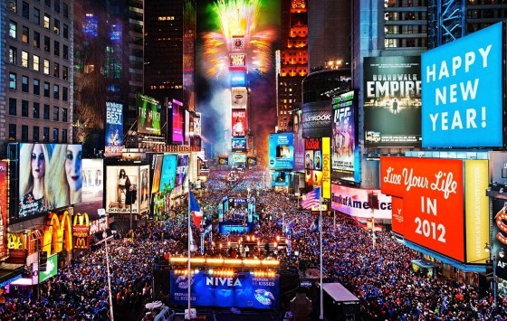
Celebrating the New Year
Puerto Rico
United States
Notes:
While many countries have their own special holidays, there are also some that are similar from country to country. For example, most countries celebrate the beginning of the new calendar year.
United States
In the United States, we typically celebrate New Year’s by spending time with friends and family.
Often times, we attend large parties and decorate with streamers, party hats, confetti, etc.
It is also a tradition in the United States to stay up until midnight, so that we can watch the ball drop in Times Square and celebrate the official beginning of the New Year.
Puerto Rico
In Puerto Rico, New Year’s is also spent with friends and family. Puerto Ricans love to throw large parties for the holiday, as well. However, Puerto Ricans have many New Year’s traditions that are different from those in the United States.
For example, they throw buckets of water out the windows to protect their homes and have a lucky year. One of their most popular traditions is to eat 12 grapes for each strike of the clock at midnight. If you can eat all 12, then you will have a year filled with prosperity. Of course, these are just a few popular Puerto Rican New Year’s traditions.
Many families, in both Puerto Rico and the United States, have their own special traditions.
Can you think of any traditions that your family does for the New Year?

Slide 6
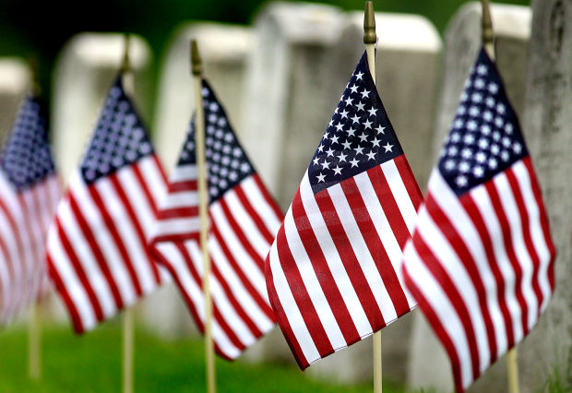
Remembering Loved Ones
Memorial Day
Day of the Dead
Notes:
In many countries, there are holidays that people celebrate to remember loved ones and those we have lost.
United States
In the United States, we celebrate Memorial Day in May to remember those that have lost their lives fighting for our country. Memorial Day is often celebrated with ceremonies and parades that honor those that have passed, as well as our military.
Mexico
In Mexico, they celebrate the dead, as well. However, they do this in a different way than we do here in the United States. The Day of the Dead is celebrated in Mexico in November. This holiday is to remember and honor family members that have passed away. Some families visit gravesites, while others decorate elaborate altars with candles, flowers, and food that honor the dead. Mexicans also make sugar skulls to honor the spirits that have descended from above during this time. Parades and festivals are also commonly attended among Mexicans during this holiday.

Slide 7
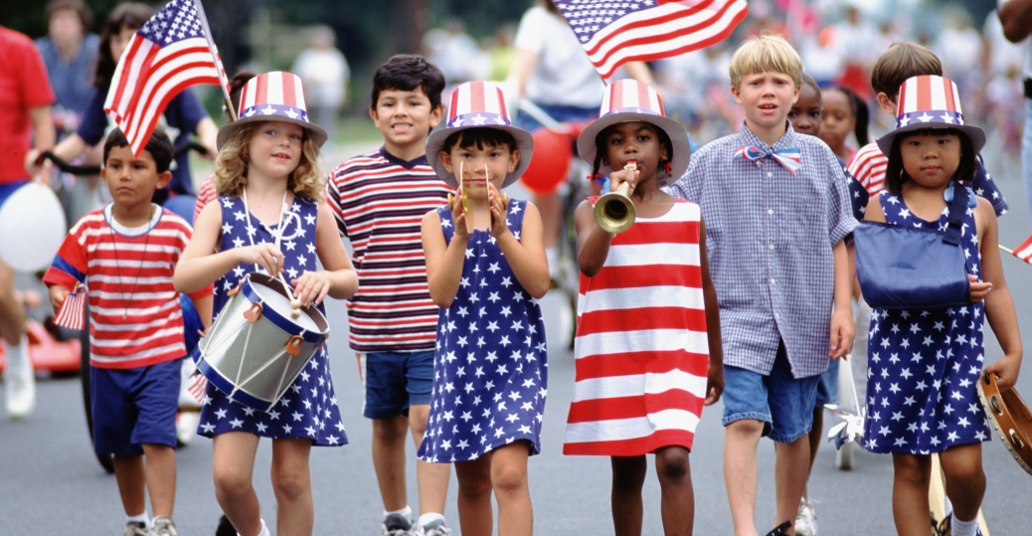
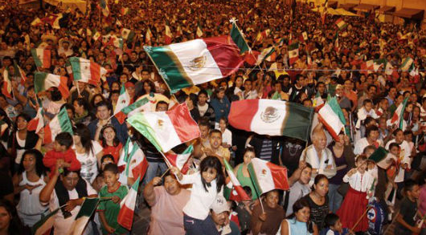
Celebrating Independence
USA Independence Day
Mexican Independence Day
Notes:
Many countries also have holidays every year that celebrate the birth of their nation.
United States
For example, Americans celebrate the Fourth of July each year. The Founding Fathers of our country signed the Declaration of Independence on July 4, 1776. This called for a separation from Great Britain and the formation of a brand new nation.
We celebrate the 4th of July with parades, picnics, and parties. Typically, we wear our nation’s colors: red, white and blue. Many people also carry the United States flag, which is symbolic of the 50 states and the freedom and liberty that our forefathers created for us. Many times, the military will join together to celebrate this important day.
Mexico
Mexicans have their own Independence Day in September. It celebrates their independence from Spanish rule.
Mexicans also celebrate with parades, festivals, and parties. It is also a tradition for Mexicans to display their nation’s flag on this day. Military members march in parades to celebrate the formation of their country.
Mexico does have some traditions different from the United States, however. Typically, the President of Mexico rings a large bell at the National Palace in Mexico City the night before the holiday.

Slide 8
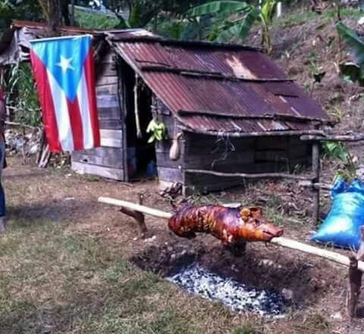
Rochester Voices
Interview with Justin Delinois
(High School student of Puerto Rican and Haitian descent)
http://www.rochestervoices.org/historical-media/interview-justin-delinois/
Minute 15:20-15:30 (Pig Roast)
Notes:
For this slide, please visit http://rochestervoices.org and go to the “Latino Oral Histories” section, and then click on “Explore This Collection.” Direct links are also included in the presentation. This is a selection of several Rochester Latinos discussing their life experiences in their home countries and in Rochester.
Now, we will listen to two short audio clips from Latinos right here in Rochester. Both discuss their own experiences with Latin American holidays and traditions. These short clips will give you an understanding of what it is like to celebrate holidays and traditions as both a Latino and an American. Keep in mind that there are popular traditions celebrated in certain countries, but also traditions celebrated within families, as well.
Justin Delinois
The first interview is with Justin Delinois, a Rochester high school student of mixed Haitian and Puerto Rican descent. Listen to minute 15:20-15:30 where Justin is explaining the traditions he brought back with him after visiting family in Puerto Rico. He describes a Puerto Rican tradition during big events and holidays of having a pig roast like the image you see here.

Slide 9
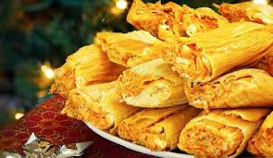
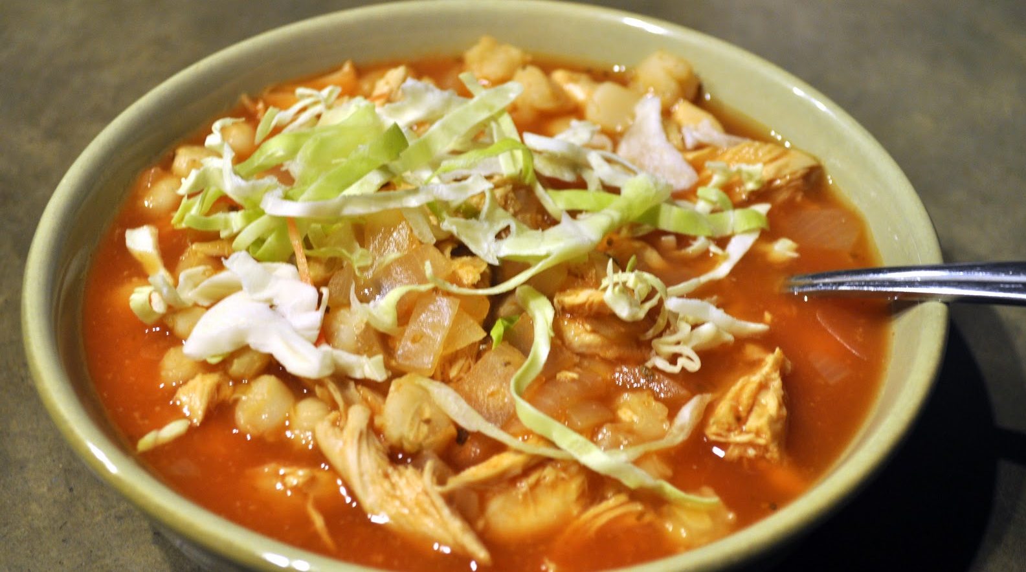
Rochester Voices
Interview with
Marilu Segura
(Mexican-American)
“We incorporate both cultures on Thanksgiving (Tamales and Pozole).”
http://www.rochestervoices.org/historical-media/interview-marilu-segura/
(Min 34:14-35:04)
...on Thanksgiving
              Tamales
              Pozole
Notes:
Caption: We incorporate both cultures on Thanksgiving (Tamales and Pozole).
For this slide, please visit http://rochestervoices.org and go to the “Latino Oral Histories” section, and then click on “Explore This Collection.” Direct links are also included in the presentation.
Marilu Segura
The second interview is with Marilu Segura, a mother who was born in Mexico and now lives with her family in the United States. Listen to Min 34:14-35:04 where she is explaining how her family celebrates Thanksgiving by eating turkey and also pozole (a soup with hominy and meat) and tamales (made of corn meal and meat or cheese in the center).

Slide 10
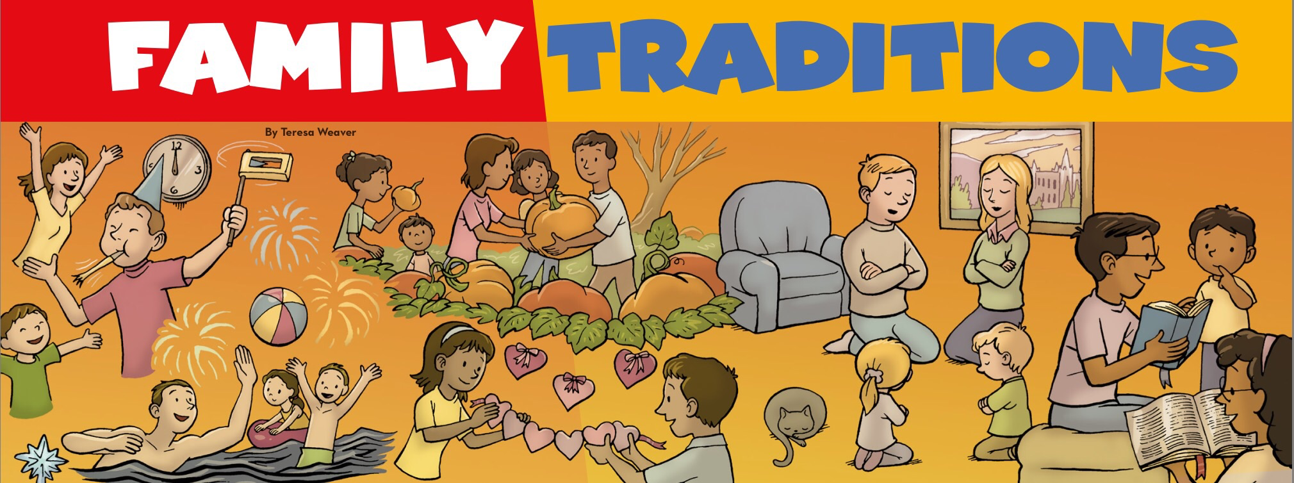
Family Traditions and Holidays
Notes:
Families all over the world enjoy practicing certain traditions. Traditions are normally practiced year after year because it allows families to come together and spend time with one another.
Often times, these traditions are practiced during holidays when people have off from school and work. Since there are so many different countries in the world, many people celebrate different holidays.
Homework
Tonight, go home and ask your family what cultural background(s) they identify with. Then, have them list three traditions that are celebrated within your own family.
Please use homework sheet provided to record your answers and bring them to class tomorrow. It will be interesting to compare the different traditions within our families.

