Slide 1
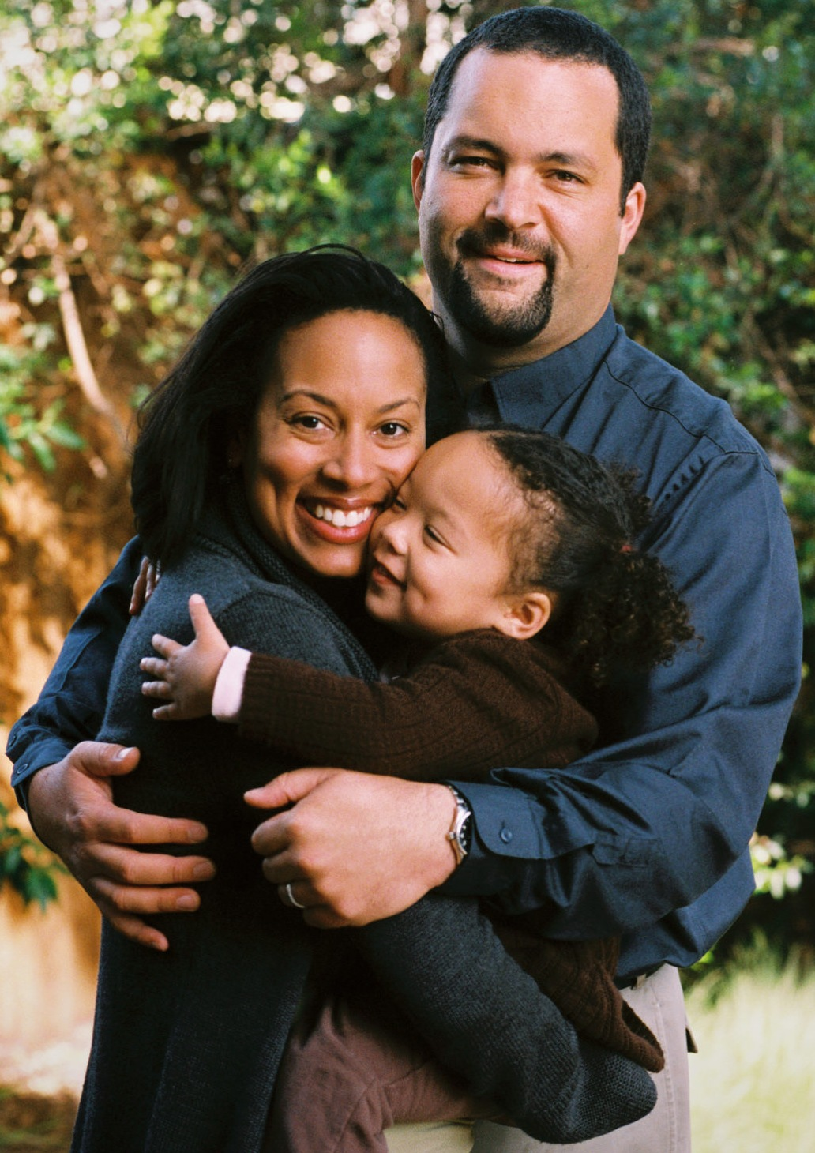

What does it mean to be Latino?
3rd Grade, Lesson 1

Slide 2
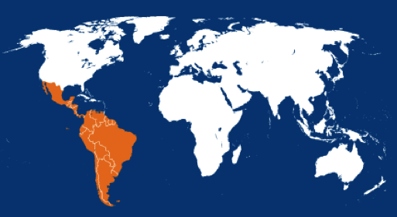
Where is Latin America?
Notes:
All countries Southwest of the Rio Grande and the United States.
There are many countries that are part of the region, including: Argentina, Colombia, Mexico, Nicaragua, and Puerto Rico.
Many people in these countries speak Spanish as their first language.

Slide 3
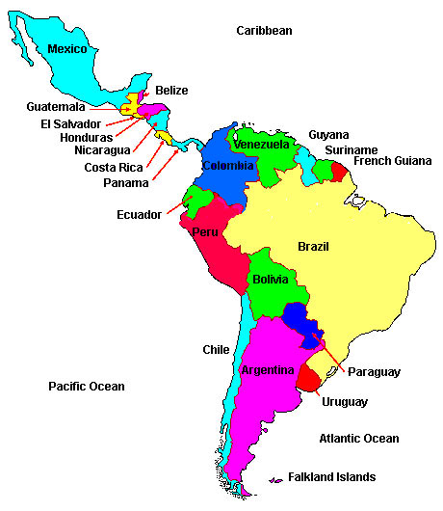
Latin America
There are 26 countries in Latin America.
Notes:
The figure shows the 26 countries that are part of the Latin American region.
Have you heard of any of these countries before?

Slide 4
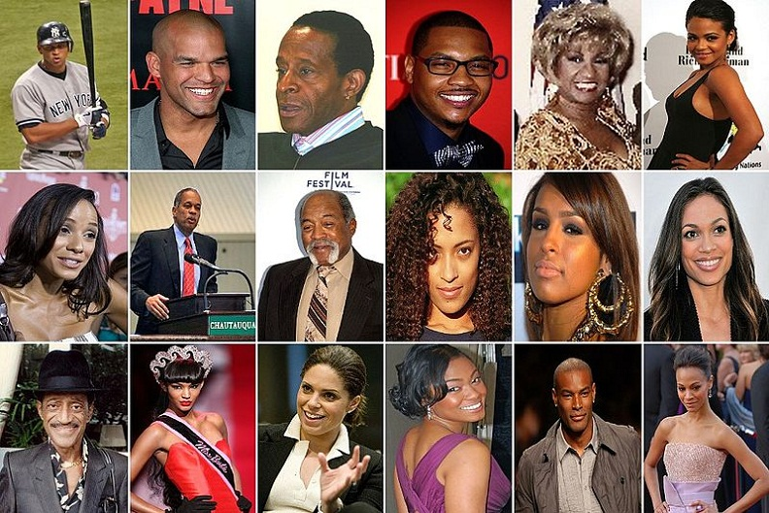
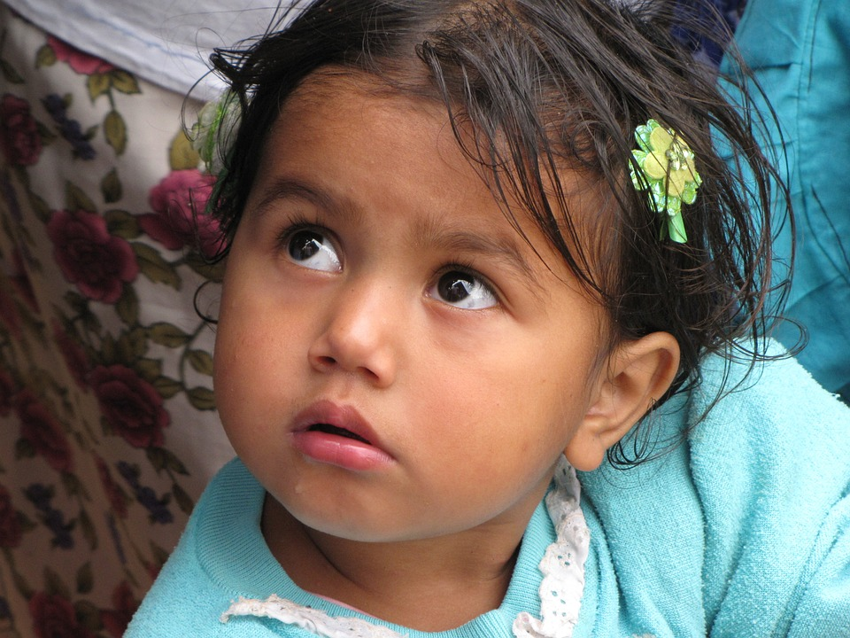

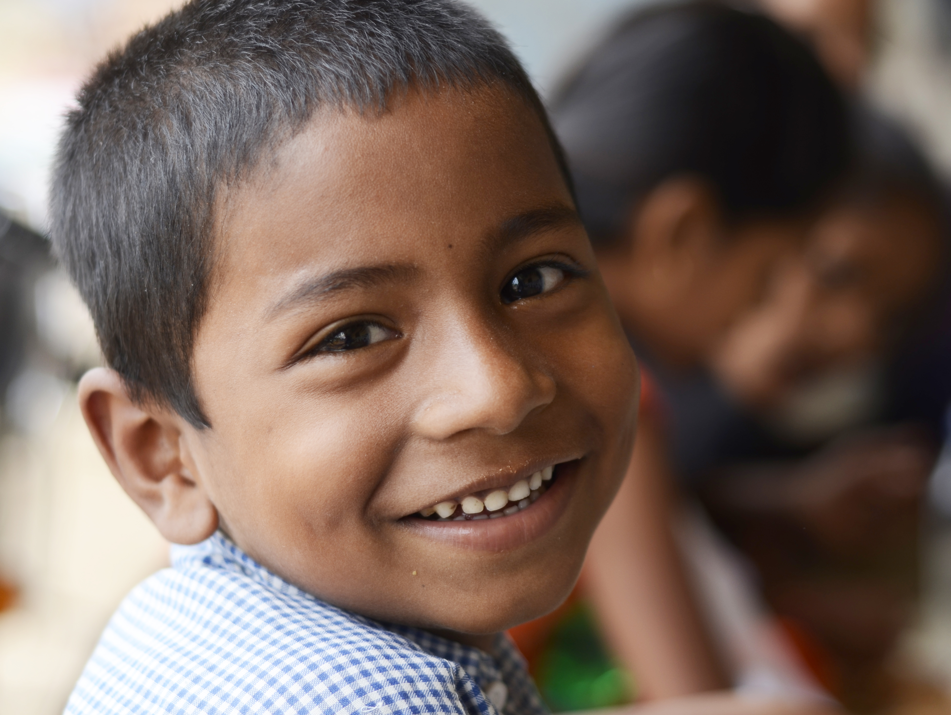
What is a Latino or Latina?
Notes:
A person with cultural ties to Latin America.
In Spanish, a “Latino” is a male; “Latinas” are females.
Many Latinos and Latinas live in the countries where they were born.
Sometimes, Latinos and Latinas leave their countries and start families elsewhere. Many come to the United States.
When a person settles in a new country, he or she is called an immigrant.

Slide 5
Quick Check
How many countries are there in Latin America?
26 countries
What is a Latino/Latina?
A person that has cultural ties to Latin America.
What do many Latin Americans speak as their first language?
Spanish
Do all Latin Americans live in their home countries?
No, some leave their home countries and move to other countries, like the United States.
What is an immigrant?
A person who settles in a new country.
Notes:
This slide is a Quick Check for student understanding. It is set with Slideshow Animation to reveal questions and answers one click at a time

Slide 6
Part 2: Country Groups
Overall History
  3000 BCE-1500:
  Native Americans settle
  and thrive
  1500s: Spanish conquest
  1500s-1800s: Native Americans, Africans, Europeans live under Spanish rule
  1810s-1820s: Wars for independence from Spain
  (except Puerto Rico)
Notes:
Argentina, Colombia, Mexico, Nicaragua, and Puerto Rico were all inhabited with Native Americans. The natives were eventually conquered by the Spanish with the help of rival native groups and some Africans.
Later, millions of Africans were forcibly brought to these countries as slaves to work. In the early 1800s, the mixed populations of Africans, Europeans, and Native Americans went to war with Spain to establish the independent countries they are today. All but Puerto Rico became independent republics by the 1820s.
Puerto Rico’s local leaders felt dependent on Spain's administrative and military assistance, and did not seek independence. To reward past loyalty and ensure future support, the government of Spain granted economic liberties to Puerto Ricans. The reforms opened the island's ports to foreign trade, permitted Roman Catholic immigration, and granted free land to the new settlers. In 1898, after the brief Spanish-American War, in the United States won Cuba, Puerto Rico, the Philippines, and other colonial possessions from Spain under the Treaty of Paris. Puerto Ricans were prevented from implementing a new government. Instead, Puerto Ricans were only allowed to elect 30 delegates of the lower house, while the U.S. president appointed the island's governor, cabinet, and all judges. In 1917, Puerto Rico was declared a U.S. territory and citizenship was granted to Puerto Ricans.

Slide 7
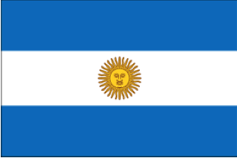
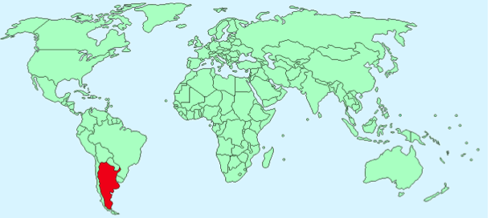
Group #1: Argentina
Notes:
Official Language: Spanish
Population: 42,192,494 in 2012
Capital: Buenos Aires
How was Argentina created?
1516: An explorer named Juan Diaz de Solis discovers the region, and it is quickly claimed by Spain.
1816/1817: Argentina becomes it’s own country by declaring independence from Spanish rule.

Slide 8
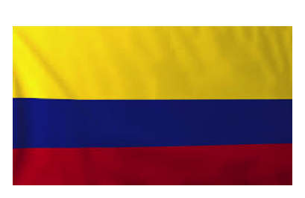
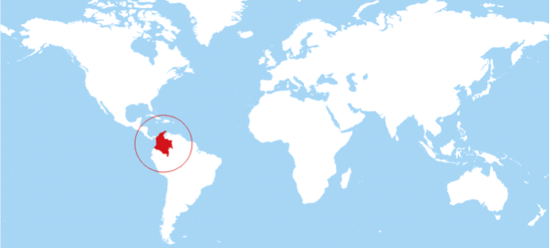
Group #2: Colombia
Notes:
Official Language: Spanish
Population: 44,725,543 in 2011
Capital: Bogotá
How was Colombia created?
3,000 BC: Natives set up villages along the coastlines.
1538: Gonzalo Jiménez de Quesada conquers the Chibcha people.
1819: After Simón Bolívar fights and defeats Spain, Nueva Granada is downsized. It was a combination of present-day Colombia and Panama.
1863: Colombia finally stands on its own as the United States of Colombia.

Slide 9
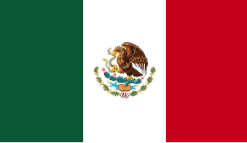
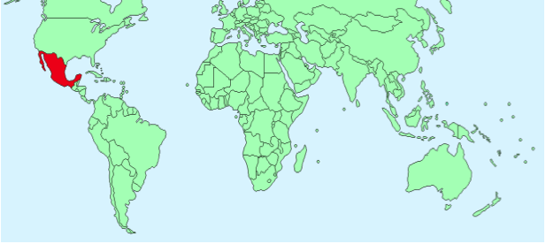
Group #3: Mexico
Notes:
Official Language: Spanish, as well as various native languages
Population: 120,286,655 in 2014
Capital: Mexico City
How was Mexico created?
300-900 AD: The classical period of the ancient Mayans, Zapotecan, and Teotihuacán people.
1519-1521: A Spanish explorer named Hernando Cortés arrives with his men, and they conquer the Mexican region.
1821: Mexico declares its independence from Spain.

Slide 10
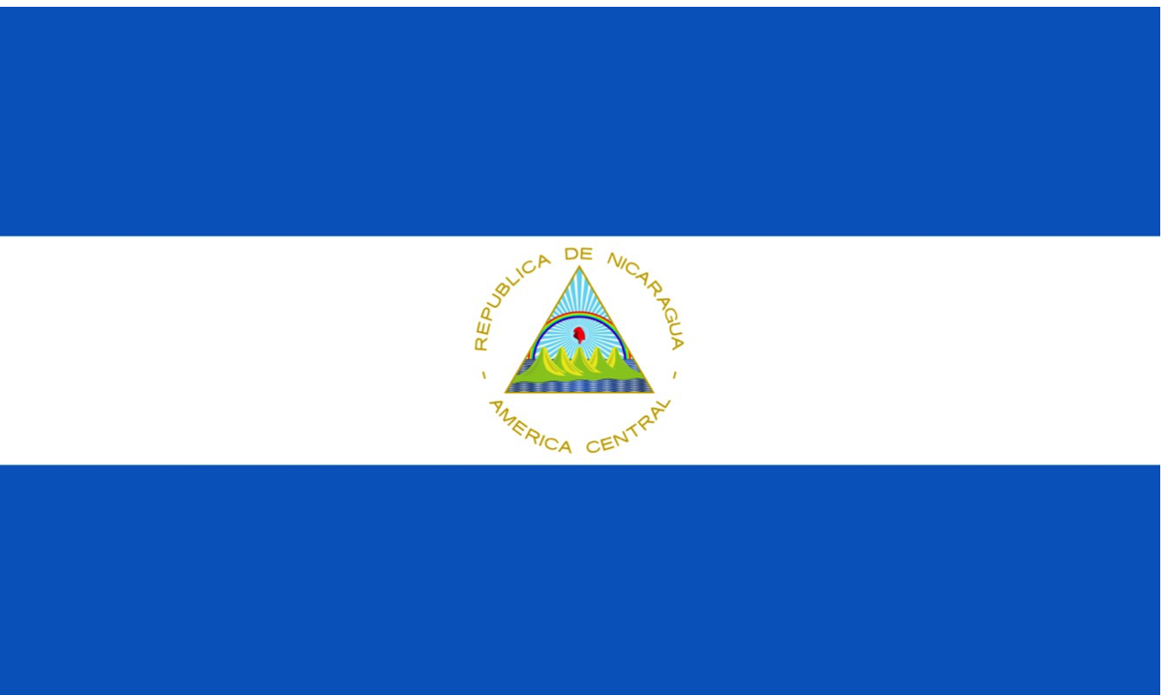
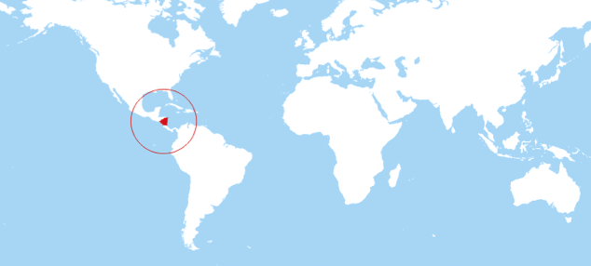
Group #4: Nicaragua
Notes:
Official Language: Spanish
Population: 5,666,301 in 2011
Capital: Managua
How was Nicaragua created?
500: Early people settle in present day Nicaragua.
1522: Spanish explorer Gil Gonzalez Davila discovers the territory and names it after its chief, Nicarao.
1821: Nicaragua declares their independence from Spain and becomes part of Mexico.
1823: Nicaragua joins the United Provinces of Central America.
1838: Nicaragua breaks away from the United Provinces of Central America and becomes its own, fully independent nation.

Slide 11
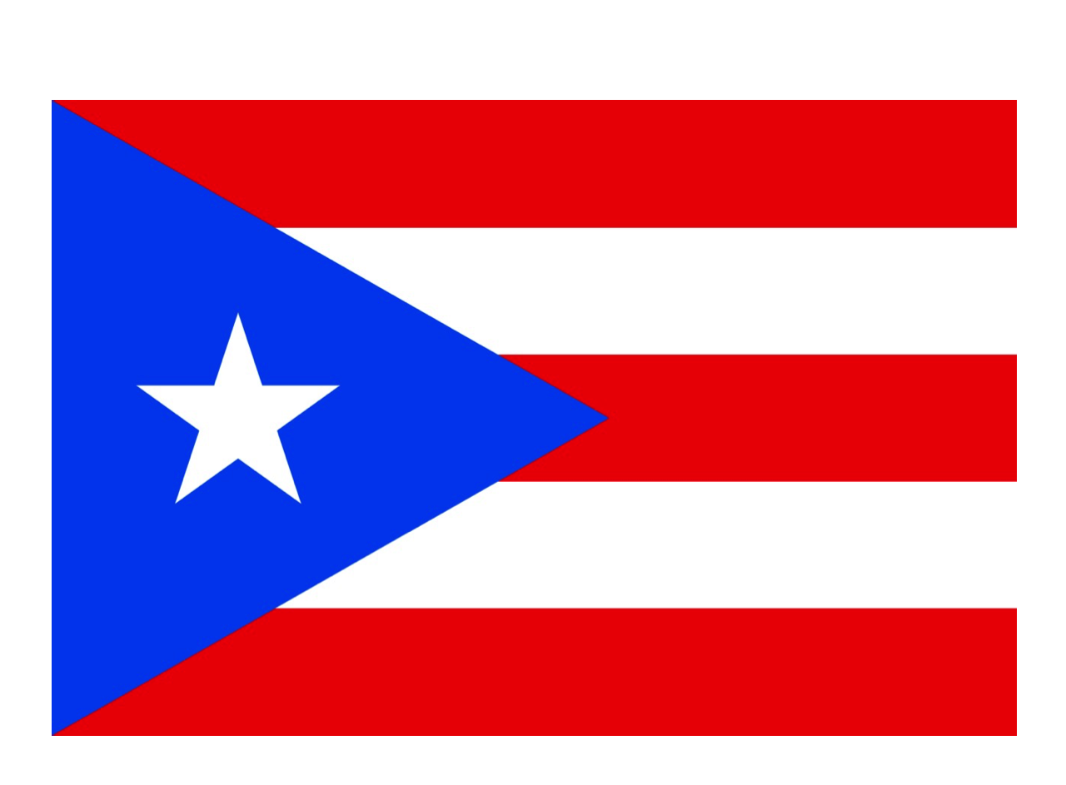
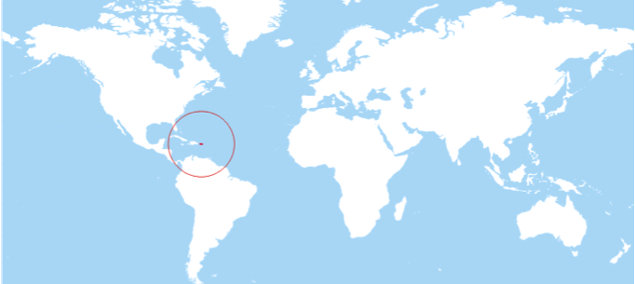
Group #5: Puerto Rico
Notes:
Official Language: Spanish and English
Population: 3,989,133 in 2011
Capital: San Juan
How was Puerto Rico created?
1000 AD: Taíno Indians discover and settle in present-day Puerto Rico.
1493: Christopher Columbus claims the island for Spain on his second voyage to the Americas.
1898: After the Spanish American war, Spain officially hands over Puerto Rico to the United States.
1952: At this time, Puerto Rico becomes a commonwealth of the United States with powers to self-govern.

