Slide 1
Latin American Immigration
4.7: Immigration and Migration from the Early 1800s to the Present

Slide 2
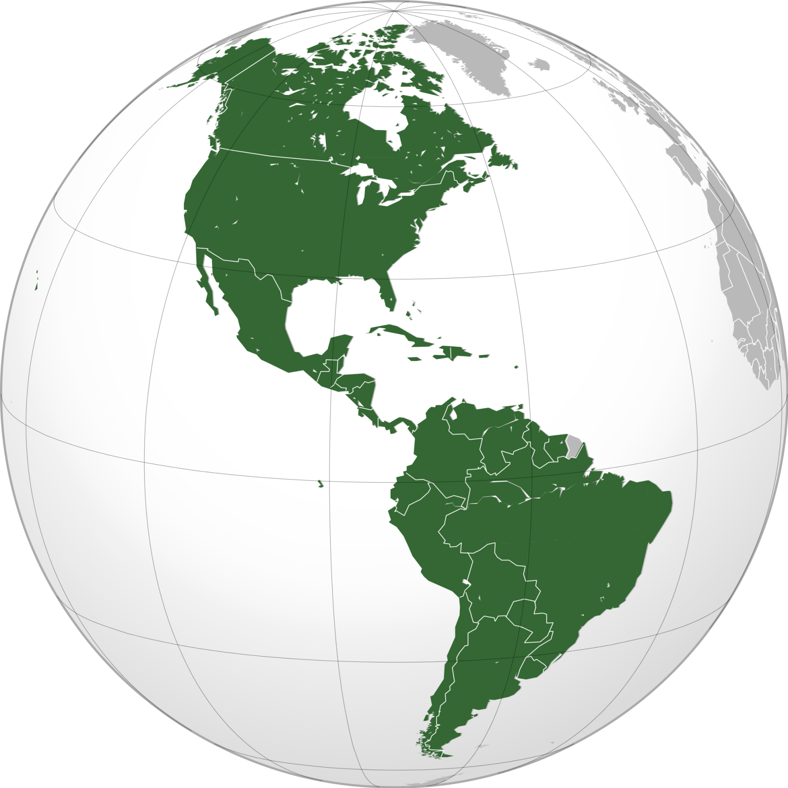
Where in the world are we?
Canada
North America
United States
Mexico
Caribbean
Central America
Latin America
South America

Slide 3
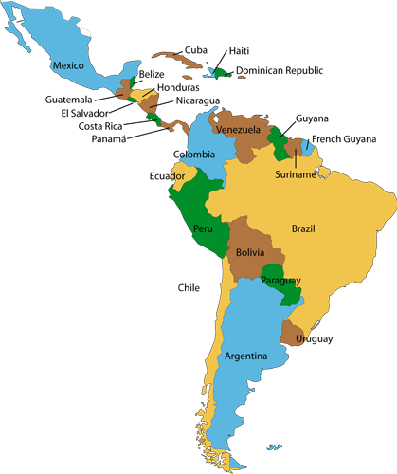
Countries of Latin America

Slide 4

Puerto Rico
Puerto Rico
First significant immigration: Late 1940s
Reason for leaving: Agricultural decline and unemployment
Where they settled: 75% settled in northeastern states

Slide 5
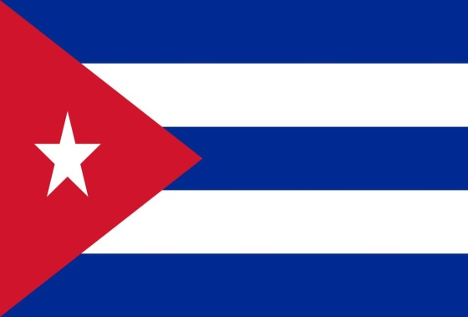
Cuba
First significant immigration: Began in 1959
Reason for leaving: Problems in the government led to revolution
Where they settled: Florida first. A Cuban refugee program helped settle Cubans throughout U.S., mostly in northeastern states.

Slide 6

Domincan Republic
First significant immigration: Began in 1960
Reason for leaving: oppressive government
Where they settled: 67% settled in New York and New Jersey.

Slide 7
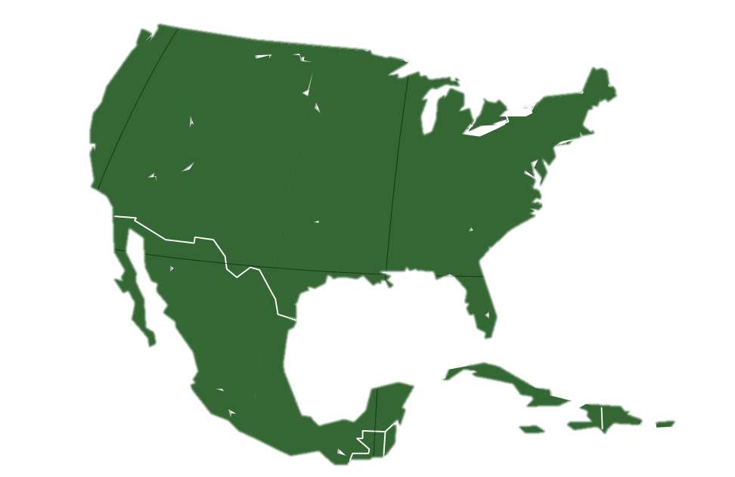
Day 2: A Different Lifestyle
New England
New York
Florida
Cuba
Puerto Rico

Slide 8
Language
Hola!
United States: English
Puerto Rico: Spanish and English
Cuba: Spanish
Dominican Republic: Spanish
Cómo te llamas?

Slide 9
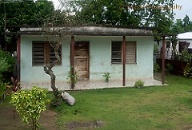
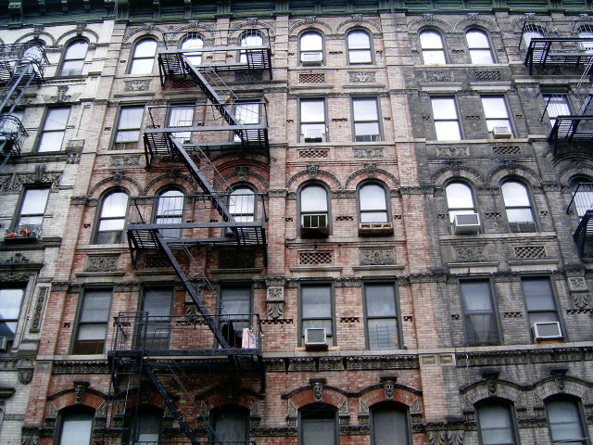
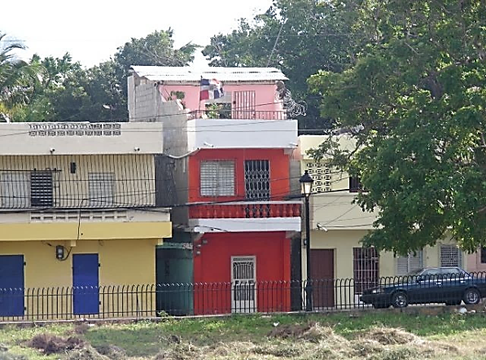
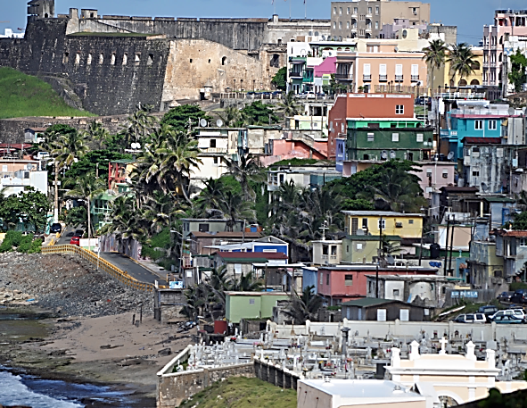
Housing (1950-1960)
Cuba
Dominican Republic
New York
Puerto Rico
Notes:
Most moved from rural (countryside) houses to tenement buildings in cities.

Slide 10
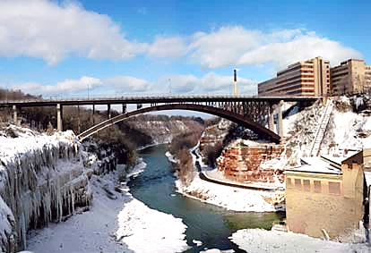
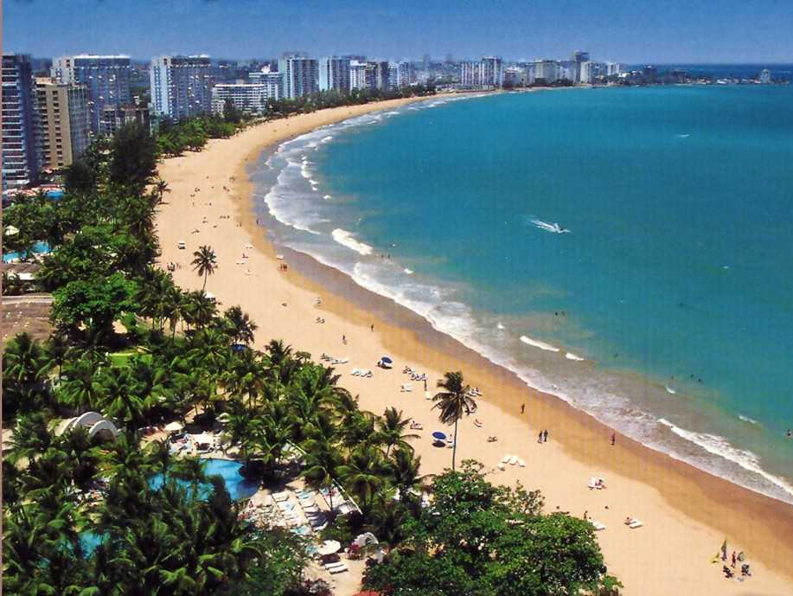
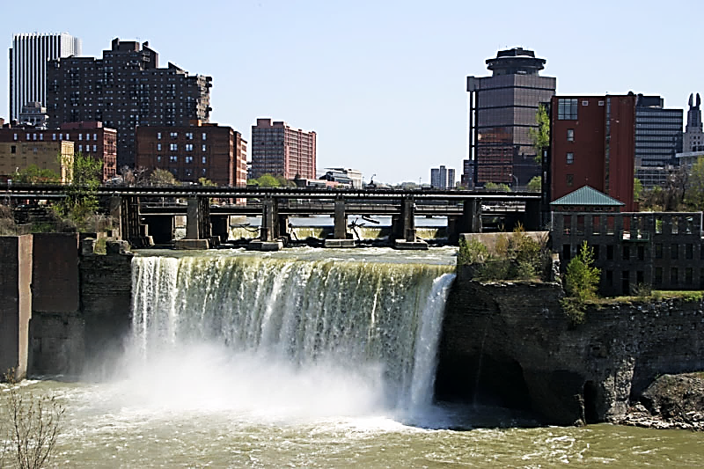
Weather
New York Weather: 20° - 85°
Island weather: 70° - 90°

Slide 11
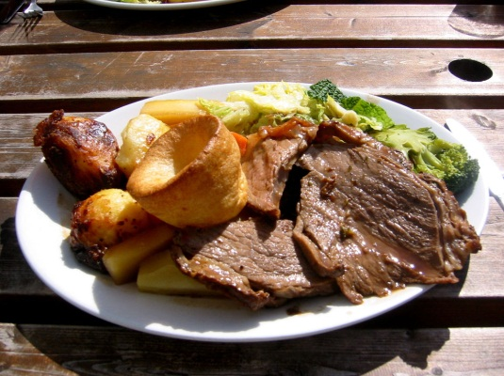
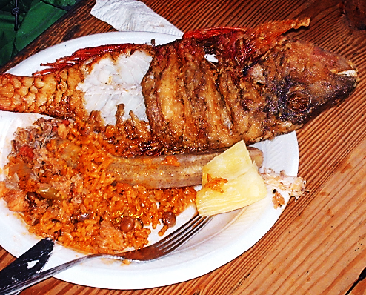
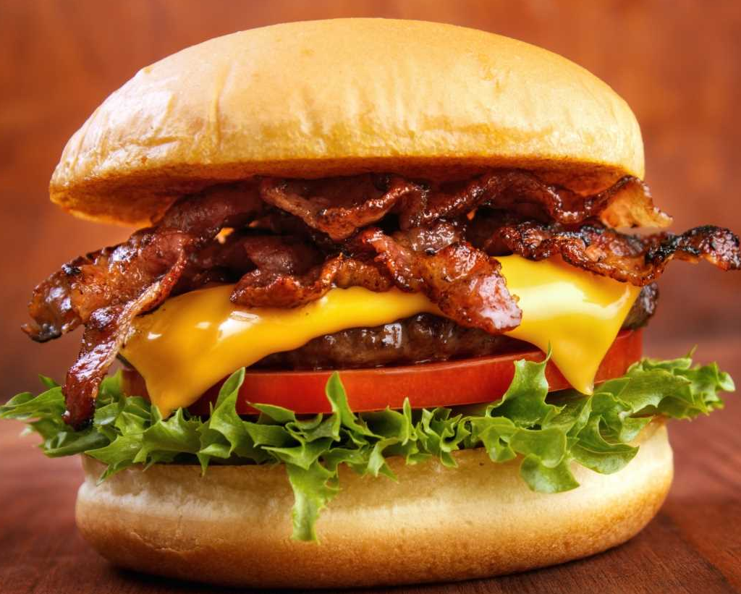
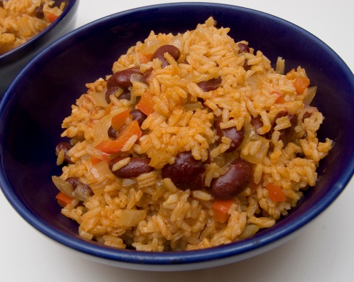

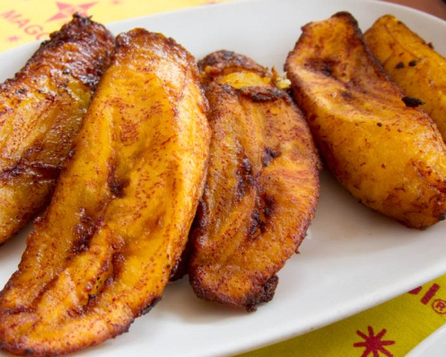
Food
American food
Island food
Roast Beef
Seafood
Cheeseburger
Rice and beans
Apple pie
Plantains

Slide 12
Ways to Adapt
Language
Housing
Weather
Food

Slide 13
Day 3: Employment
American Jobs

Slide 14
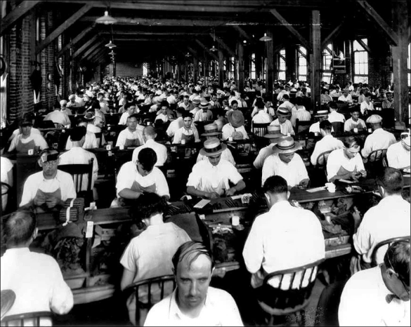
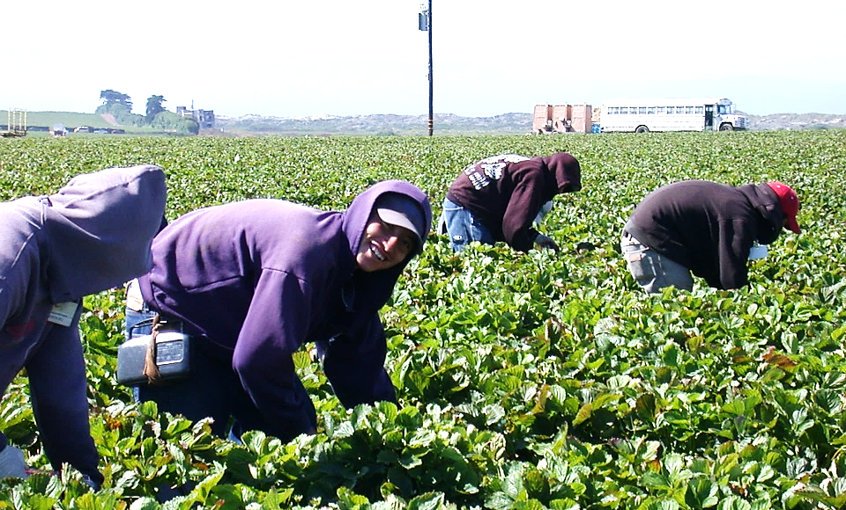
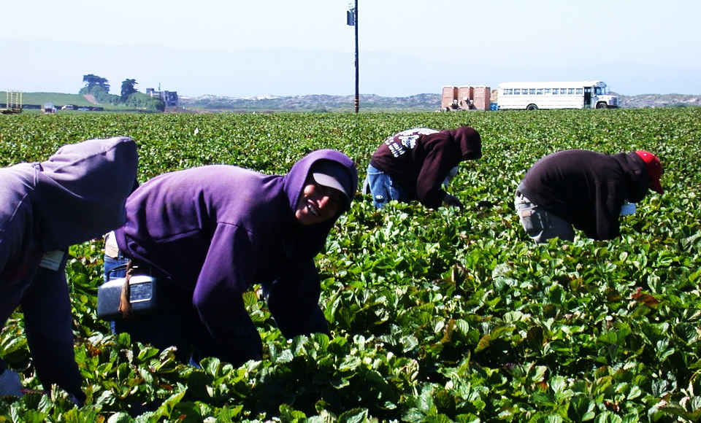
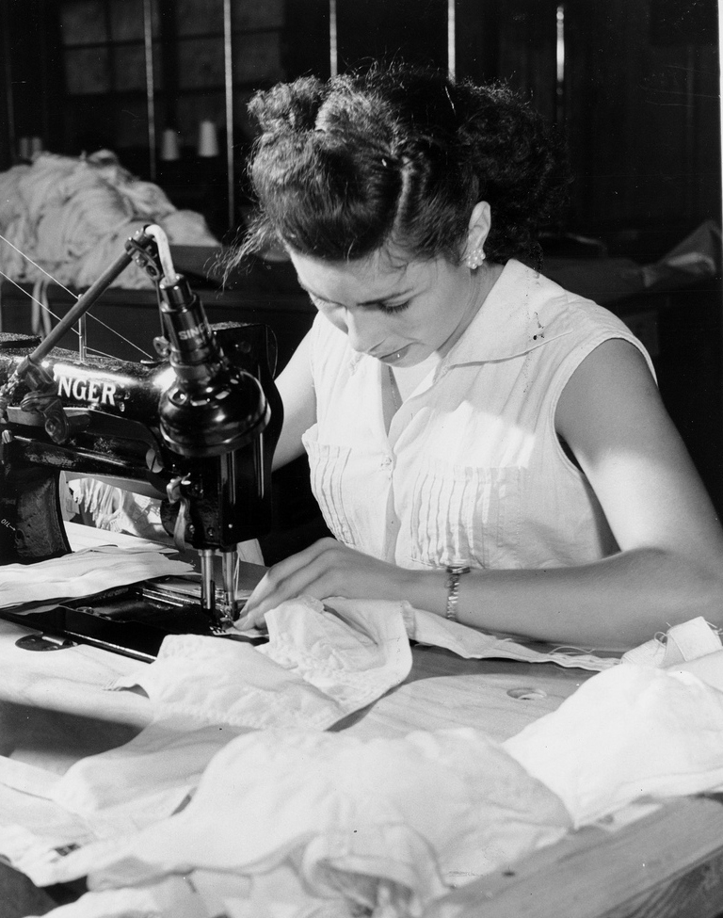
Work Experience for Latinos
1950s, 1960s, and 1970s
Factory workers
Household workers
Service workers
Laborers
Garment industry
14

Slide 15
Working Conditions
Often cramped, hot, dangerous and physically demanding

Slide 16

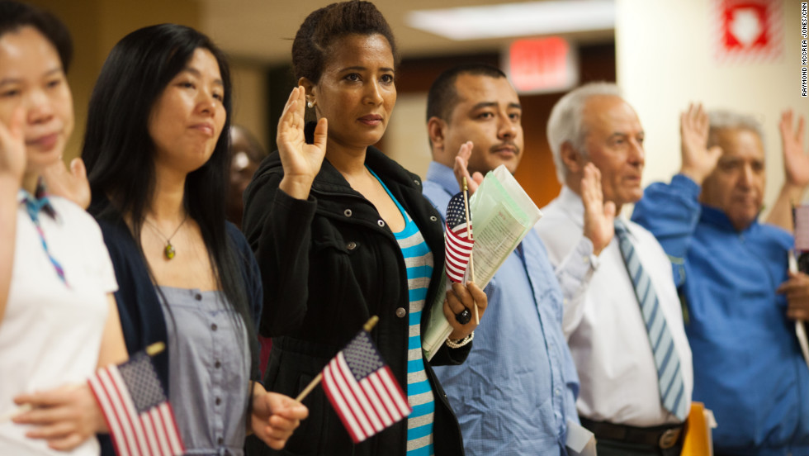
Naturalization Test

